Slide 1

Capgemini: A Look at the Company
Presented by SHREYASH S. NIKAM
Subject : Principles of Economics & Software Project Management
ROLL NO : SY24INT008
Division : SY B-Tech (A)
Department : Information Technology
Directed By : Mrs. Latika Desai

Slide 2
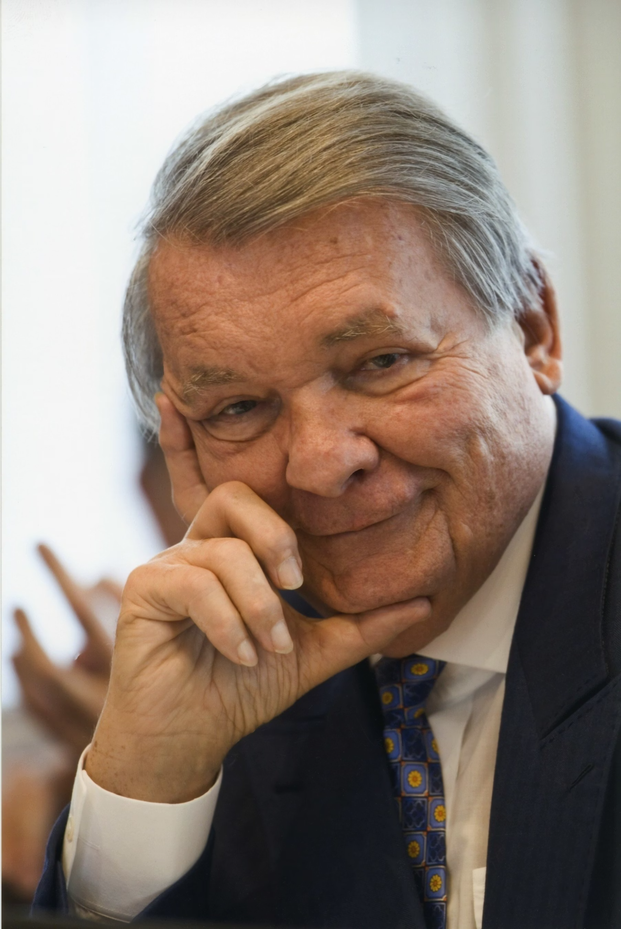
About Capgemini
Capgemini, a global leader in consulting, technology services, and digital transformation, has a rich history rooted in innovation and client partnership.
Established: 1967
Founder: Serge Kampf
Headquarters: Paris, France
Company Type: A service-based organization, Capgemini specializes in helping businesses leverage technology and strategic consulting to navigate complex challenges and achieve growth.

Slide 3






Key Technologies and Services
Capgemini empowers its clients to transform and perform through a comprehensive suite of services, focusing on cutting-edge technologies that drive modern business.
Cloud Services
Data & AI
Enabling seamless migration, management, and optimization of cloud infrastructures for enhanced agility and scalability.
Harnessing the power of data and artificial intelligence to unlock insights, automate processes, and drive intelligent decision-making.
Cybersecurity
Digital Transformation
Building robust defense mechanisms and strategic frameworks to protect businesses from evolving cyber threats and ensure data integrity.
Guiding organizations through their digital journey, integrating new technologies to revolutionize operations and customer experiences.

Slide 4
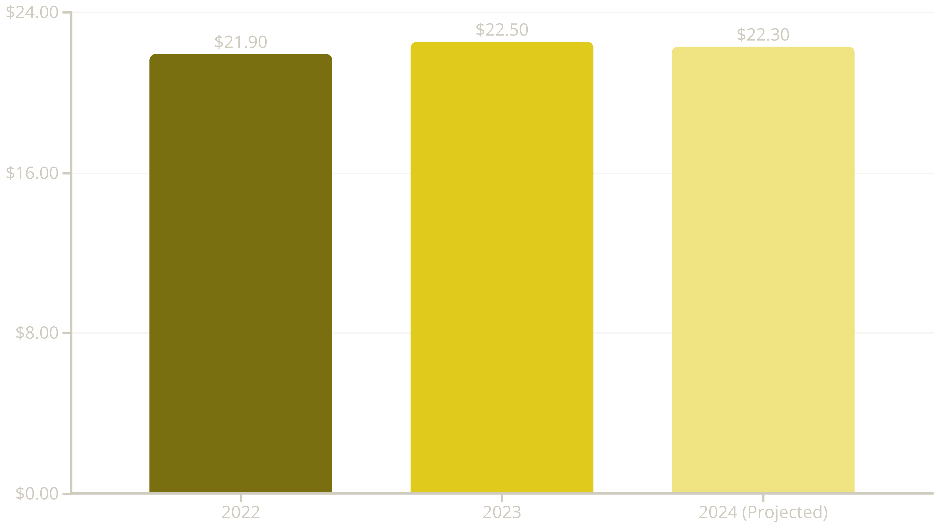
Market Performance: A 3-Year Overview
Capgemini has demonstrated consistent revenue growth over the past three years. Revenue saw a slight increase in 2023, reflecting steady market performance. While 2024 projections indicate a modest decrease due to a tighter global economic market, the company maintains a strong financial footing.

Slide 5












Capgemini's Purpose & Values
Capgemini's enduring success is built on a foundation of strong values and a clear purpose, guiding its approach to business and societal impact.
Honesty
Team Spirit
Upholding integrity and transparency in all interactions.
Fostering collaboration and collective success.
Freedom
Boldness
Empowering individuals and fostering creativity.
Embracing innovation and forward-thinking solutions.
Fun
Modesty
Cultivating a positive and engaging work environment.
Remaining humble and open to continuous learning.
Company Purpose: "Unleashing human energy through technology for an inclusive and sustainable future." Capgemini is committed to using its technological expertise to benefit society and create a better world for all.

Slide 6

Global Reach and Innovation Hubs
A Connected World of Expertise
Capgemini's expansive global presence allows it to serve diverse clients across continents, leveraging local insights with worldwide capabilities. The company operates numerous innovation centers that serve as incubators for new ideas and technological advancements.
Presence in over 50 countries: Delivering tailored solutions globally.
Strategic Innovation Hubs: Centers in key cities worldwide drive research and development, focusing on emerging technologies like AI, blockchain, and quantum computing.
Diverse Talent Pool: A multicultural workforce fosters a rich environment for problem-solving and creative solutions.

Slide 7

Thank You !!

